Slide 1
Effective Power to Govern - BTI 2018 Index
File created on: 10/31/20 11:29:44 PM EDT

Slide 2
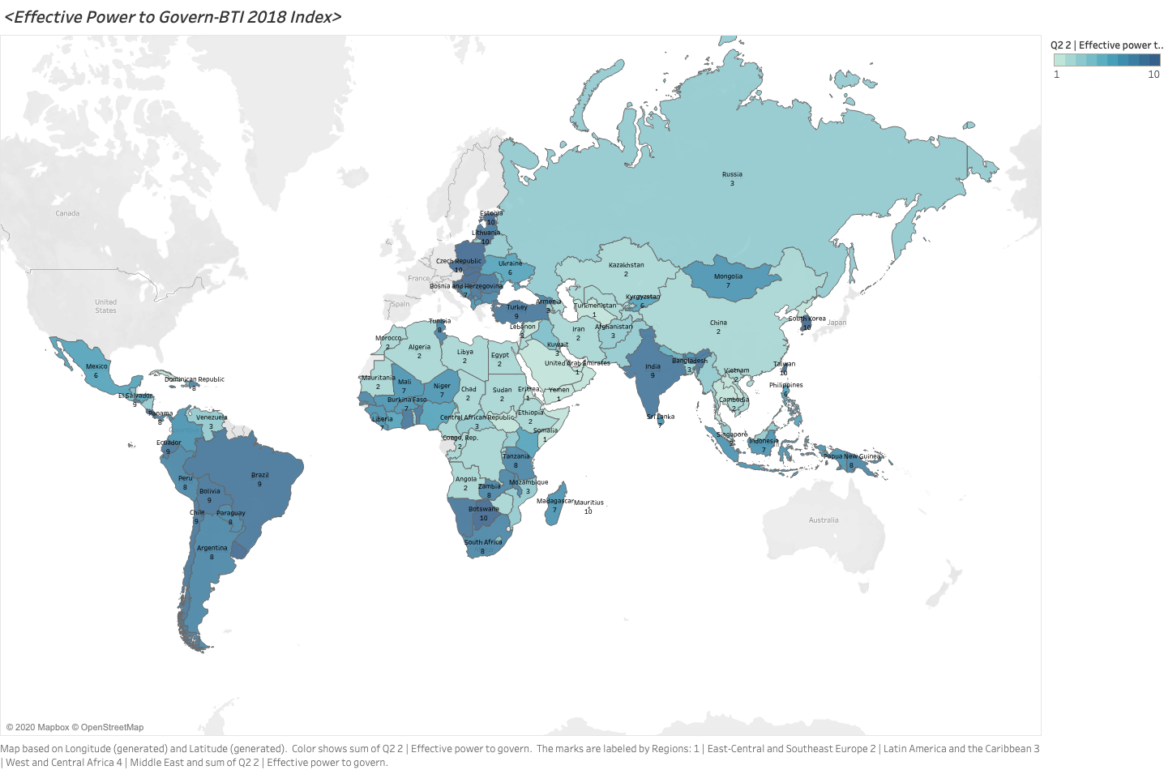

Slide 3
